Slide 1
COLLECTIVE LIST-ONLY ENTITY LINKING: A GRAPH-BASED APPROACH
ANIKA BABU
S7 BTECH CSE
CLASS NO:11
24 OCTOBER 2018

Slide 2
CONTENTS
Collective list only entity linking : A graph based approach
Introduction
Existing methods
Proposed Method
Pre-processing Step
Entity Information Enrichment
Graph Construction
Conclusion
References

Slide 3
INTRODUCTION
Collective list only entity linking : A graph based approach
What is List-only entity linking(EL)?
Mentions
Character strings
Eg : Jackson, Newyork Knicks
Entity list
group of correlated entities.
Eg : Cities,Teams

Slide 4
INTRODUCTION (contd…)
Collective list only entity linking : A graph based approach
Uses :co-occurrences of information in entity list.
Local compatibilities are considered.
Disambiguation using graph

Slide 5
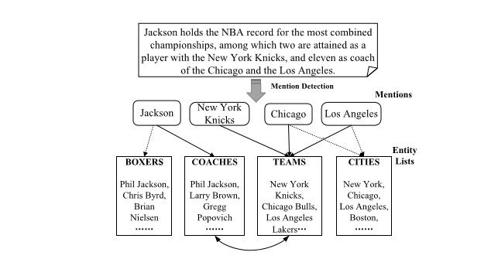
Collective list only entity linking : A graph based approach
INTRODUCTION(contd…)
Courtesy :https://ieeexplore.ieee.org/stamp/stamp.jsp?arnumber=8320777

Slide 6
EXISTING METHODS
Collective list only entity linking : A graph based approach
Traditional EL methods
Uses Knowledge bases
Offers rich semantic information
Inapplicable when little information is available.
Existing EL methods
Entity coherence not considered.
Results were support less.

Slide 7
PROPOSED SYSTEM
Collective list only entity linking : A graph based approach
3 steps
Pre-processing step
Optional Named Entity Recognition process
Candidate entity generation process
Entity Information Enrichment
Description of entities are provided.
Graph-based Entity disambiguation
An entity graph is constructed – Gloel

Slide 8
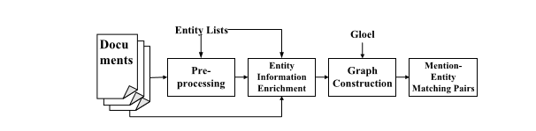
PROPOSED SYSTEM
Collective list only entity linking : A graph based approach
Courtesy :https://ieeexplore.ieee.org/stamp/stamp.jsp?arnumber=8320777

Slide 9
PREPROCESSING STEP
Collective list only entity linking : A graph based approach
Detecting mentions
Generating candidate entities for each mention
- based on simple string matching rules
- eg : Chicago → Chicago {cities}
: Chicago → Chicago Bulls{Teams}

Slide 10
PREPROCESSING (Contd…)
Collective list only entity linking : A graph based approach
String Matching Rules :
RULES | EXAMPLES
Containment | Chicago → Chicago Bulls
Partial Matching | President Trump → Donald Trump
Alternative Names | National Capital → Washington D.C. Smiley → Miley Cyrus

Slide 11
ENTITY INFORMATION ENRICHMENT
Collective list only entity linking : A graph based approach
Enrich information on entity side .
Select representatives from input documents
Candidate representatives
Extract text around all mentions in all documents.

Slide 12
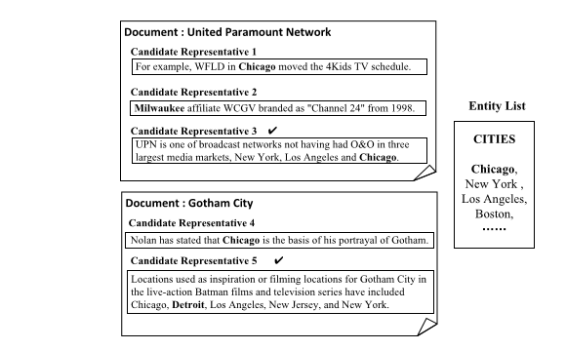
ENTITY INFORMATION ENRICHMENT
Collective list only entity linking : A graph based approach
Courtesy :https://ieeexplore.ieee.org/stamp/stamp.jsp?arnumber=8320777

Slide 13
COMPATIBILITY SCORE
Collective list only entity linking : A graph based approach
Between each mention & candidate entity.
Based on text similarity
Input: Document dᵢ and mij mention.

Slide 14

COMPATIBILITY SCORE(contd…)
Collective list only entity linking : A graph based approach
Let eᵢ ∈ Eᵣ is a candidate entity
Tʳ = {tʳ₁,….,tʳₕ}
α,β – weight coefficients
Compatibility score is measured by

Slide 15
GRAPH CONSTRUCTION AND DISAMBIGUATION
Collective list only entity linking : A graph based approach
An entity graph G={V,E} is a weighted graph
where node V – candidate entity and mention.
E – relation between these entities.

Slide 16
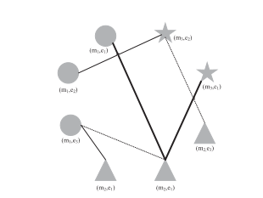
GRAPH CONSTRUCTION
Collective list only entity linking : A graph based approach
Courtesy :https://ieeexplore.ieee.org/stamp/stamp.jsp?arnumber=8320777

Slide 17
GRAPH CONSTRUCTION(contd…)
Collective list only entity linking : A graph based approach
2 nodes are connected when
Same entity list.
Appears simultaneously in candidate representative.
Other entities appears in candidate representative.

Slide 18
RELATION SCORE
Collective list only entity linking : A graph based approach
Relation between entities is considered.
Mention - irrelevant
Implicit and Explicit relations.

Slide 19


RELATION SCORE(contd…)
Collective list only entity linking : A graph based approach
Given 2 entities

Slide 20

PAGE RANK
Collective list only entity linking : A graph based approach
Graph based entity-linking algorithm
Utilises pagerank concept
Each node vₛ is assigned with a vector p(vₛ)
Each document dᵢ is assigned with a vector p(dᵢ)
Coherence Score,

Slide 21
PAGE RANK(contd…)
Collective list only entity linking : A graph based approach
Candidate entity is unambiguous if :
- eij,r is the only candidate entity of mention mij.
- When there are more than one candidate entities .

Slide 22

SELECTING MENTION –ENTITY PAIR
Collective list only entity linking : A graph based approach
For document dᵢ with mention mij
Where γ and δ are weight coefficients

Slide 23
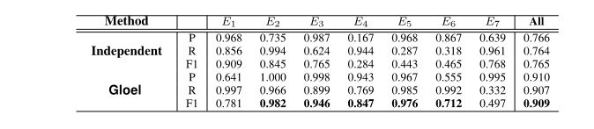
EXPERIMENTS AND RESULTS
Collective list only entity linking : A graph based approach
P – Precision
R – Recall
F1 –Balanced Indicator
Courtesy :https://ieeexplore.ieee.org/stamp/stamp.jsp?arnumber=8320777

Slide 24
CONCLUSIONS
Collective list only entity linking : A graph based approach
Utilizes entity co-occurrences information
Provides sparse information on the entity side
Improves the performance of the list-only EL

Slide 25
REFERENCES
Collective list only entity linking : A graph based approach
[1] Y. Lin, C.-Y. Lin, and H. Ji, ‘‘List-only entity linking,’’ in Proc. 55th Annu. Meeting Assoc. Comput. Linguistics, Vancouver, BC, Canada, 2017, pp. 536–541. [Online]. Available: https://doi.org/10.18653/v1/P17-2085
[2] Y. Cao, J. Li, X. Guo, S. Bai, H. Ji, and J. Tang, ‘‘Name list only? Target entity disambiguation in short texts,’’ in Proc. Conf. Empirical Methods Natural Lang. Process., Lisbon, Portugal, 2015, pp. 654–664. [Online]. Available: http://aclweb.org/anthology/D/D15/D15-1077.pdf

Slide 26
REFERENCES(contd…)
Collective list only entity linking : A graph based approach
[3] M. Pershina, Y. He, and R. Grishman, ‘‘Personalized page rank for named entity disambiguation,’’ in Proc. Conf. North Amer. Chapter Assoc. Comput. Linguistics, Human Lang. Technol., Denver, CO, USA, 2015, pp. 238–243. [Online]. Available: http://aclweb.org/ anthology/N/N15/N15-1026.pdf
[4] A. Alhelbawy and R. J. Gaizauskas, ‘‘Graph ranking for collective named entity disambiguation,’’ in Proc. 52nd Annu. Meeting Assoc. Comput. Linguistics, Baltimore, MD, USA, 2014, pp. 75–80. [Online]. Available: http://aclweb.org/anthology/P/P14/P14-2013.pdf

Slide 27
THANK YOU
Collective list only entity linking : A graph based approach

